Slide 1

STUDENTS PERFORMANCE
DAB-201 Data Visual and Reporting
Group 4
Smit Arora
Dhrumi Tapas Patel
Sameera Sameera

Slide 2
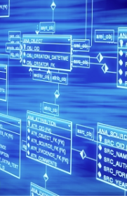
Students Performance
Dataset
Link- https://www.kaggle.com/datasets/spscientist/students-performance-in-exams
Content- This Data set consist of the marks secured by the students in high school from the United States in various subject.
Inspiration- To understand the influence of the parents' background, test preparation, etc. on students' performance.

Slide 3
Variables used for Analysis
Categorical :-
Gender
Race/Ethnicity
Parental level of Education
Lunch
Test preparation course
Numerical values:-
Maths score
Reading score
Writing score

Slide 4
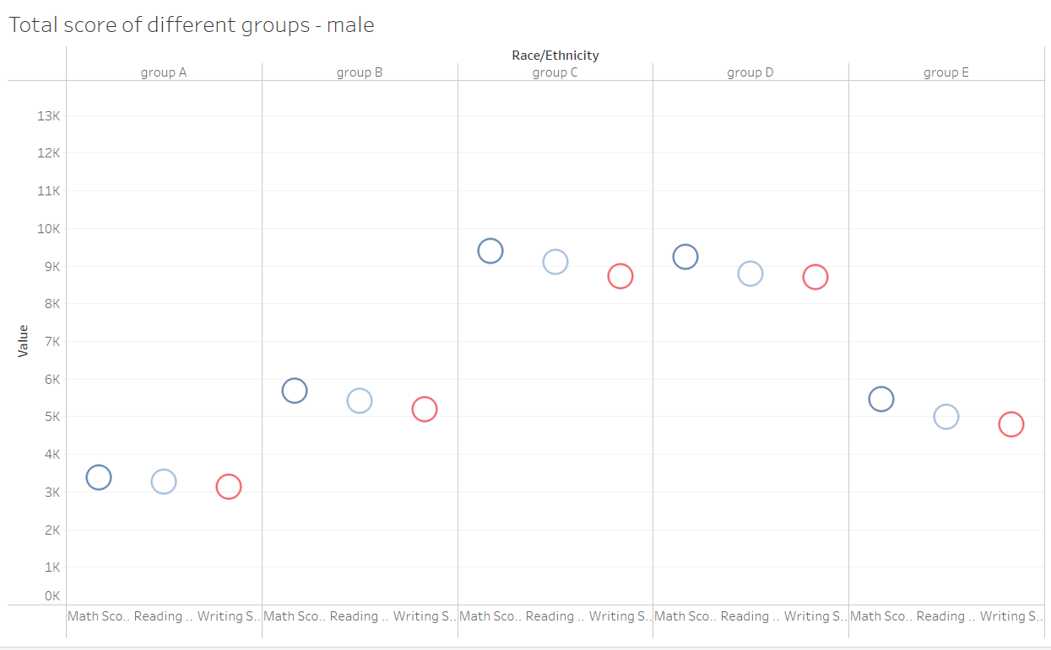
From the graph, we can observe that maximum score secured by male students were from group C and minimum from group A.
Similar is for the female students as well.

Slide 5
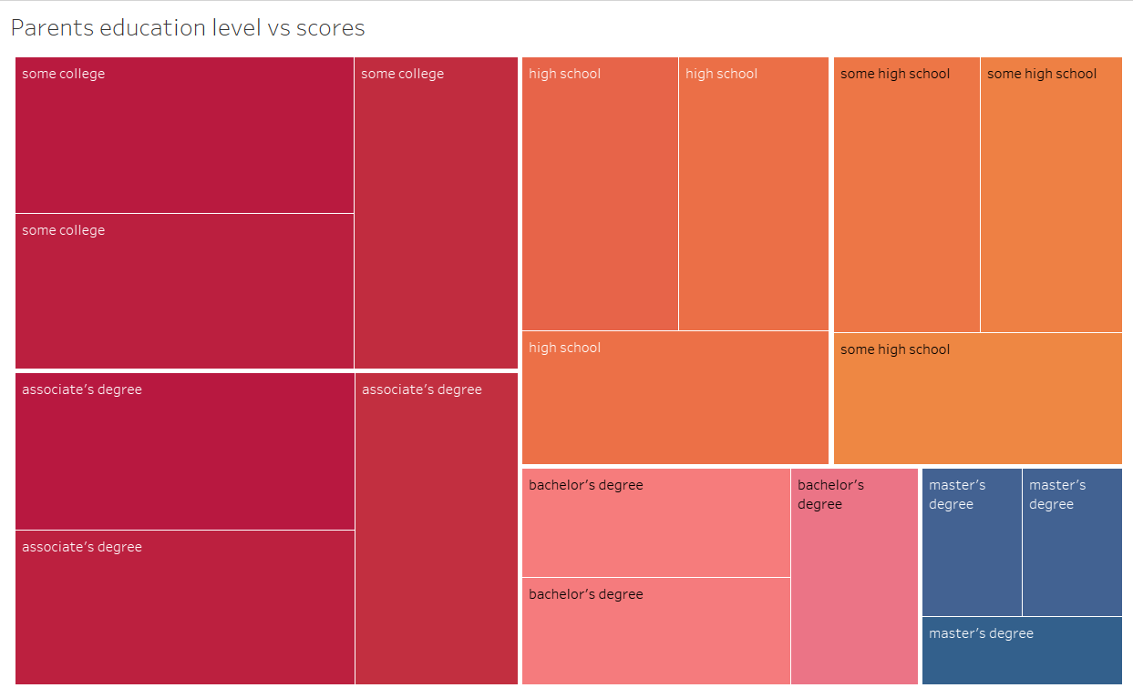
Maximum total scores of students were observed when their parents educational level was some college or had associates degree.
It was shocking to know that the scores were minimum when their parents had master’s degree.

Slide 6
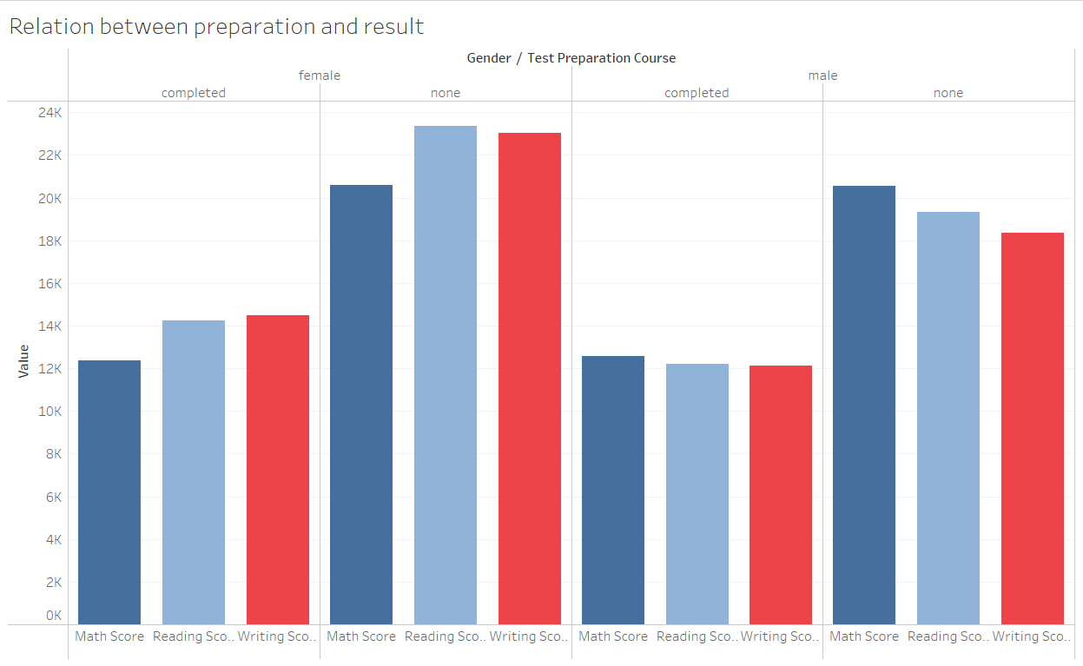
From the graph, it is hard to believe but it is observed that the total scores of students were more when they had not completed test preparation.

Slide 7
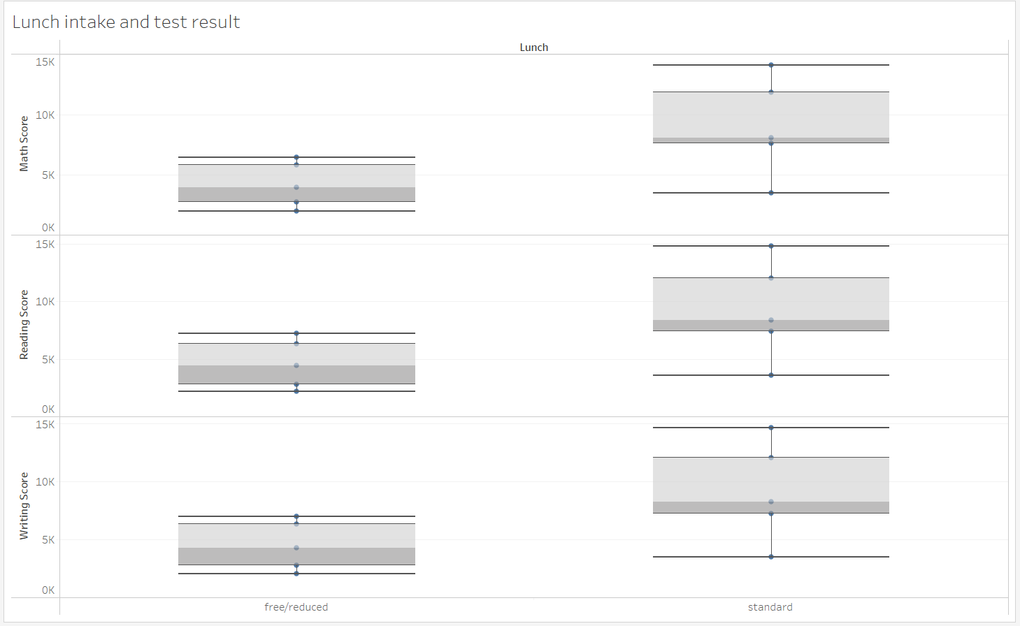
We get to know that students who had standard lunch got more total marks that the students who took free/reduced meal.

Slide 8
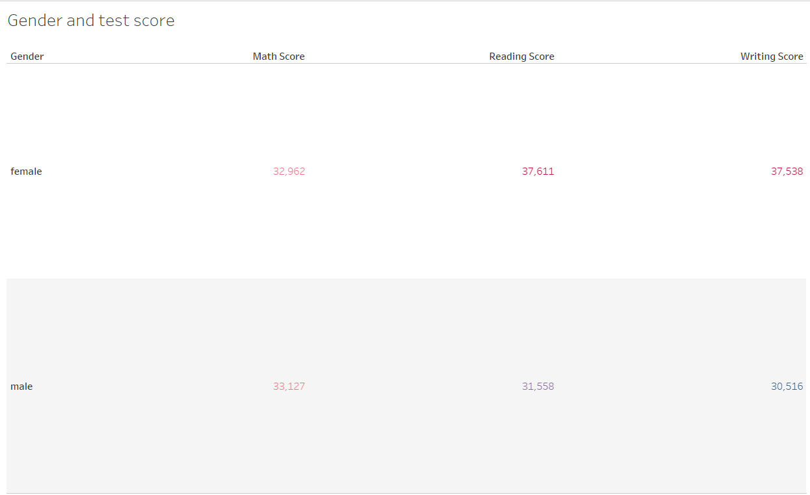
Finally, we compared gender with the sum of scores and concluded that the Math score was almost similar in both, but the total Reading and Writing score were more of female students by a good margin.

Slide 9
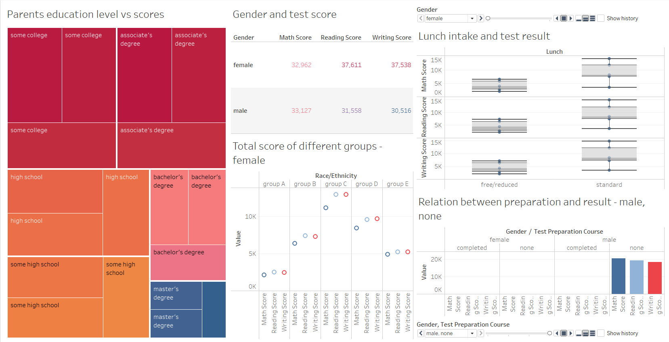
DASHBOARD

Slide 10
CONCLUSION
Overall, the pupils did better in Reading and Writing than they did in Math.
Males outperform females in math, but females outperform males in reading and writing.
The educational level of the parents doesn't appear to have a significant impact on the student's success.
Students who took a test preparation course and finished it performed bad than those who did not.
Standard lunch intake of students impacted better total scores.

Slide 11

Thank You!!!!!

